Slide 1
Python files
Non volatile storage

Slide 2
data
Where are variables stored?
Notes:
RAM, volatile, files, (or cloud)

Slide 3
Files
What operations can we perform on files?
Notes:
Open, read, write, close, delete --- why files ? Limitation of the computer

Slide 4
Last week
Variables are in RAM
Store data in files
Open, read, write, close
File object
File name

Slide 5
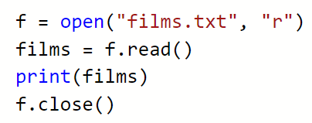
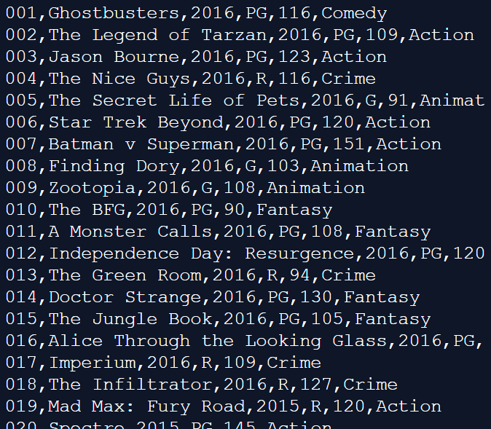
Where do you think this file is located?
r – read (why?)
w – write
rw – read & write

Slide 6
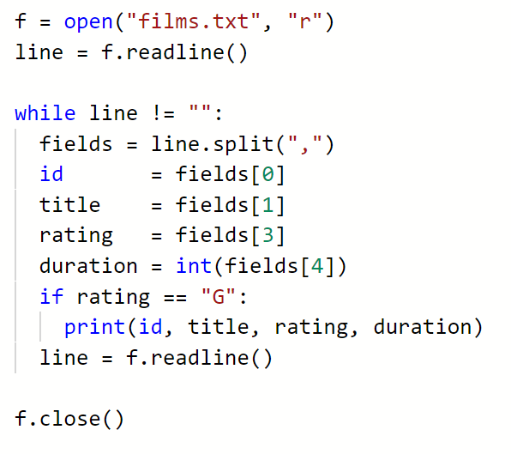
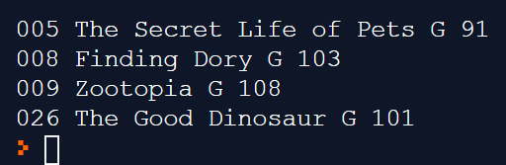

Slide 7
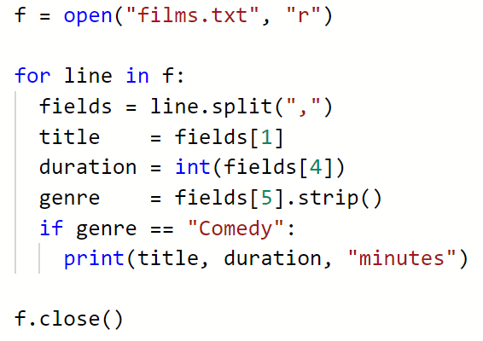
Using a for loop
Remove newline

Slide 8

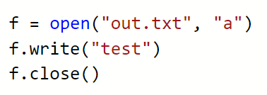
Writing to a file
New files can be written to a file by opening in write mode:
This will create a new file, if a file named films.txt already exists, it will be overwritten
It is also possible to open a file in append mode:
This will create a new file if none exists, or open an existing file and insert the line at the end

Slide 9
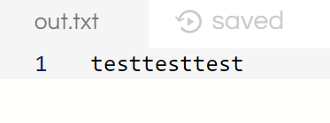

Slide 10
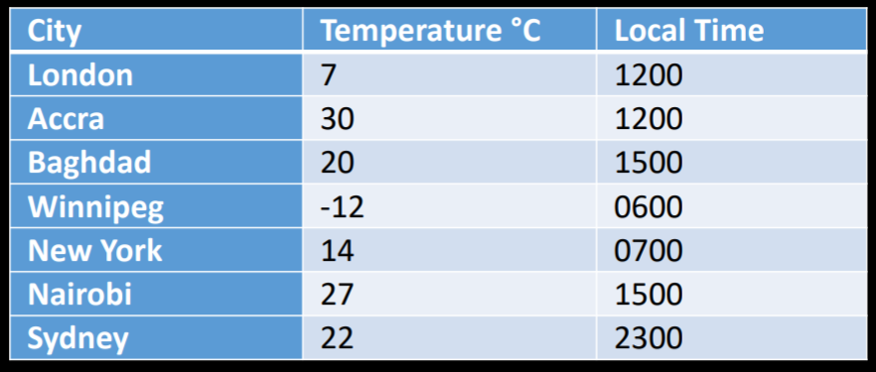
Last worksheet – output as csv
In this example, a file is created to hold data showing the local time and he temperature °C of several cities around the world on a particular day in February.

Slide 11
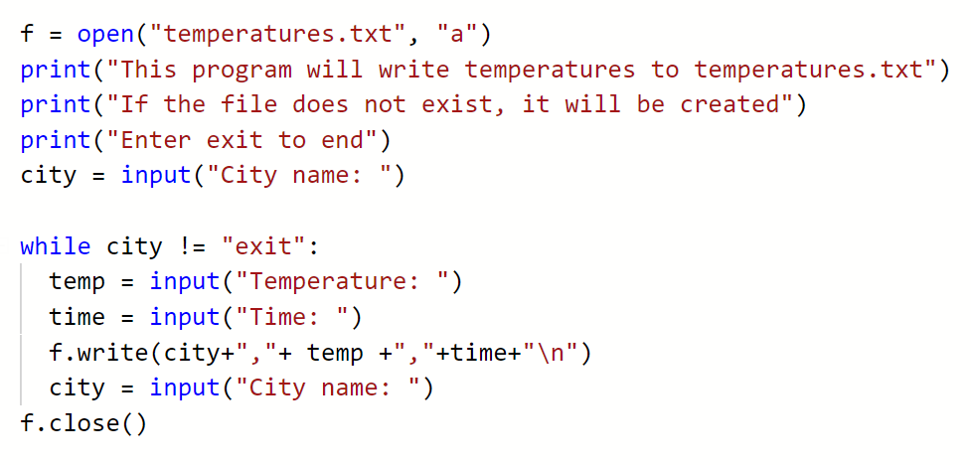

Slide 13
Today
Practice reading in data
Different data formats
Finish file tasks and worksheets

Slide 14
Today
More file operations
Different data formats
Finish file tasks and worksheets

Slide 15
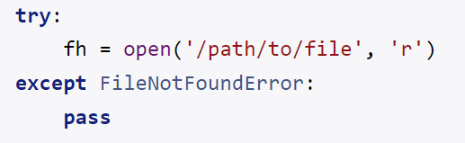
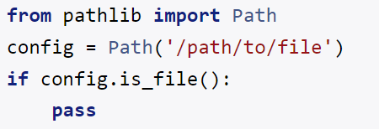
Further file operations – exists?

Slide 16

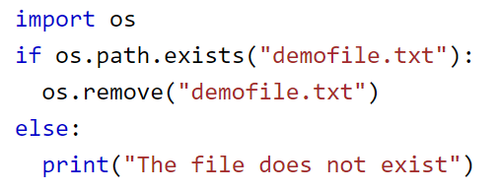

Further file operations - DELETE
Need to use the os module
Import the os module
Only if empty

Slide 17
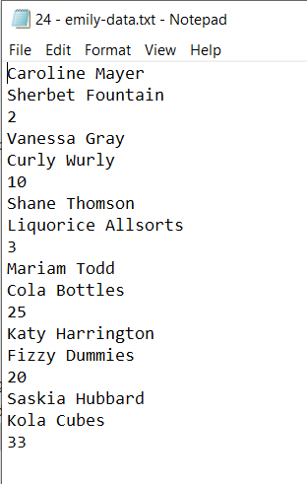
Task 1 – read in unstructured data
30
30 – Emily-data.txt
Read in data into a list
You must confirm that the data has been read in – count and confirm
You must comment your code – why not what
You should make use of well named functions

Slide 18
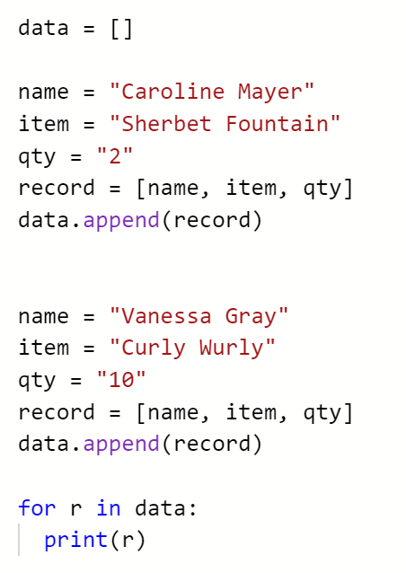
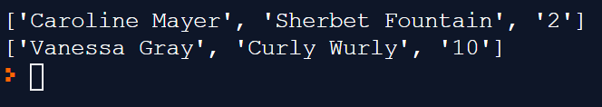
Notes:
https://repl.it/@JohnGlazebrook/emily-csv-json-pickle-access-1

Slide 19
Data format - csv
So far we have only been working with text
We saved the data as csv (comma separated values)
….
Any problems?
Notes:
Customer has two addresses (delivery and billing)? Or two phone numbers?

Slide 20
Data format - csv
So far we have only been working with text
We saved the data as csv (comma separated values)
House name, Road Name, Town
She warned me, “No! It’s dangerous.”

Slide 21
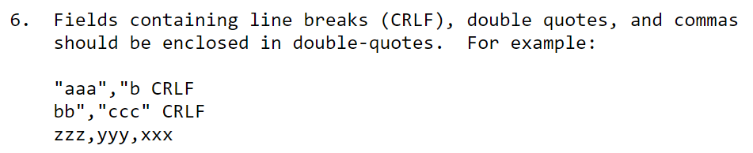
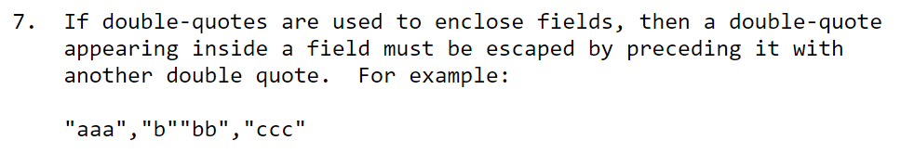
Data format - csv
Escape characters (RFC4180)

Slide 22
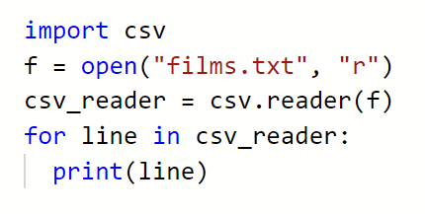
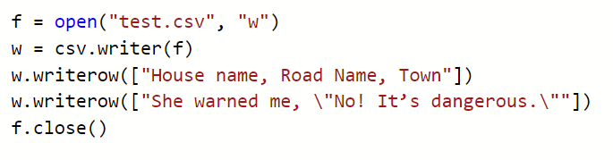
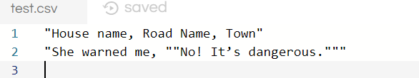
Data format - csv
Write an escape function
….
Or use the csv module

Slide 23
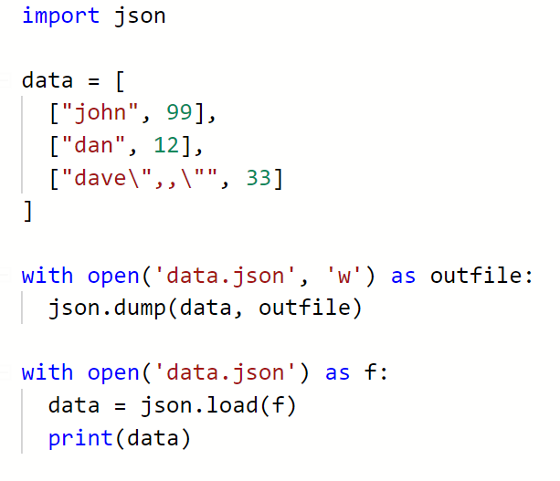
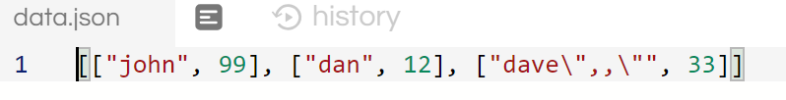

json
Another common data format is json (JavaScript Object Notation)
Used in websites, web services, config files

Slide 24
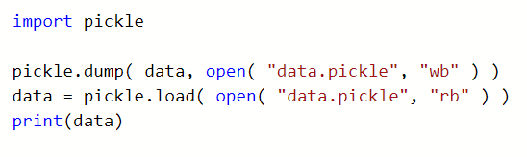
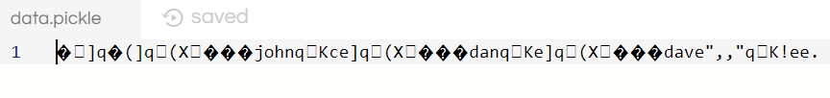
Data format - pickle
Pickle converts a python object to a character stream
Can only be parsed in python

Slide 25

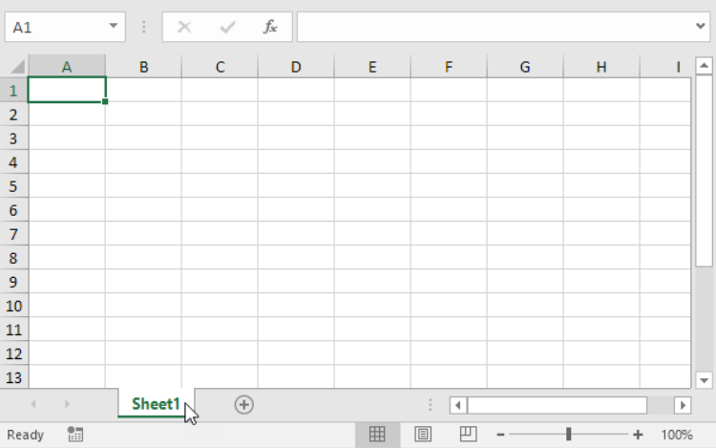
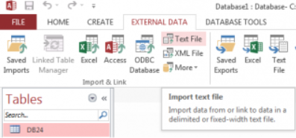
Why do we care about different data formats?
CSV – excel, access database, MySQL
CSV
GLUE

Slide 26

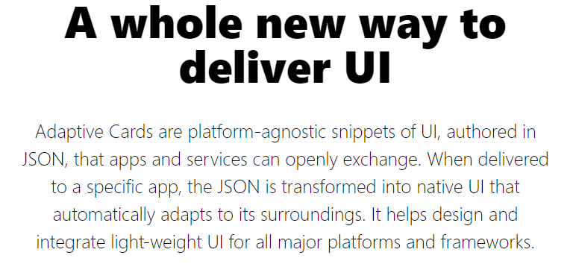
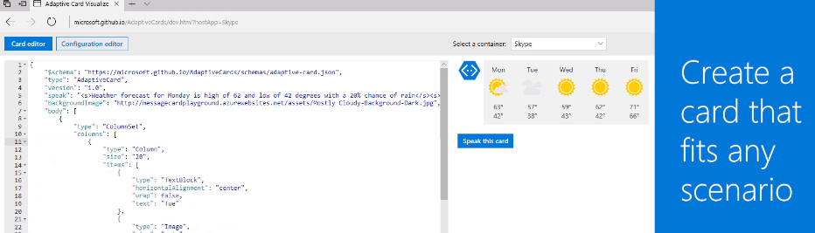
Why do we care about different data formats?
Json – the web
Web pages talk to webservers using json
Microsoft APIs all json ( including AI )
Brothers work

Slide 27
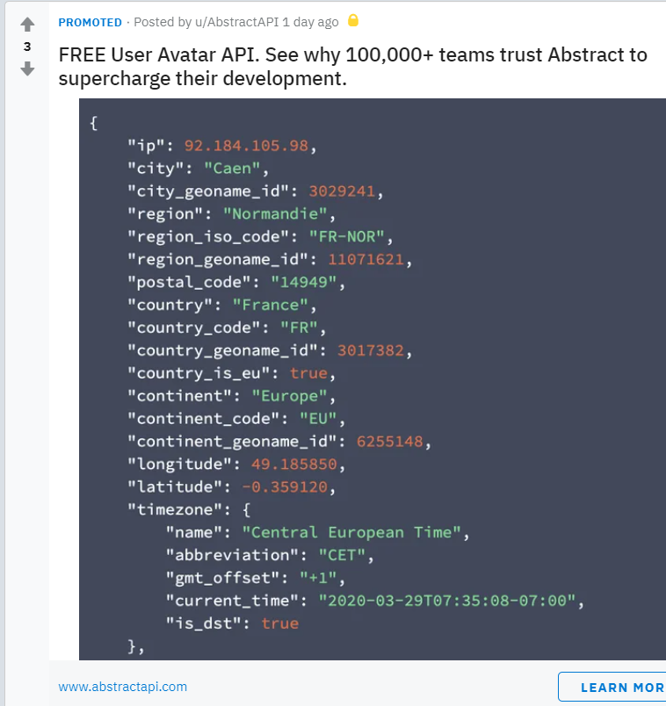
A random advert I saw on the internet

Slide 28
Why do we care about different data formats?
Pickle – compact. Easy. All Python coders know it and use it.
Python can output to json, but json can not represent all Python objects

Slide 29
Data format - ?
Can you think of any other formats?
Notes:
Bmp, gif, jpg, mp3, database

Slide 30
Data format - binary
Not human readable
More compact
(although do we care? Can we fix the size problem of text files?)
More common
Any examples?

Slide 31
Task 2
Copy / fork your code into version 2.
Output the data as
.csv
.json
.pickle
Complete the report
Notes:
https://repl.it/@JohnGlazebrook/emily-csv-json-pickle-access

Slide 32
activity
Produce the following programs
Read the file films.txt
Filter the output by genre, or date, or rating or length
Allow the user to enter city (or town) name, temperature and time
Append this data to a file

Slide 33
activity
Produce the following programs
Read the file films.txt
Filter the output by genre, or date, or rating or length
Allow the user to enter city (or town) name, temperature and time
Append this data to a file
Make sure you make use of functions.

Slide 34
Activity
An application to store student assignment scores
student name, score
Save data
Load data
Display students and scores
Display a single students score
Allow the user to choose a data format (json, csv, pickle)
Or:
game, review, score
handle, tweet, date

